Slide 1
Research Log
A Level AICE Global Perspectives
Alyssa Troy

Slide 2
Candidate: 2302 School Code:US213
I am taking this class as an independent study because I couldn’t fit the course into my class schedule. I ended up being registered into the class late, which shortened my research and writing time and eradicated class time to work on my topic and collaborate with others. There are only two other students that are enrolled in the class in the entire school since this is the first year it has been offered.
*Dates are underlined and I hyperlinked my research (it will be blue and underlined)*

Slide 3
Week One: 16 November- 22 November
Monday the 16th – Thursday the 19th: Even before officially being enrolled in the class, I was had a basic premise of what I wanted to research. I found the syllabus online and started to create a proposal poster of my own.
  My question is: Will the progression of agriculture or aquaculture provide the greatest benefit to the global society?
Friday the 20th: I was officially enrolled into the class. I talked with my Research Report Teacher (Dr. Crihfield) on how to develop and refine my question along with the requirements for the class.
Saturday the 21st & Sunday the 22nd: I finished my proposal poster and compiled everything into a detailed outline.

Slide 4
Week Two: 23 November- 29 November
Monday the 23rd: I collaborated with my two other A Level Global classmates on my outline on how to improve my proposal
Tuesday the 24th: I reviewed with my Report Supervisor (Dr. Crihfield) on my progress in refining my question and filling out my Outline Proposal Form
Wednesday the 25th: I specified my research to progressions in Agriculture
Friday the 27th: I redirected my research to aquaculture, and was surprised by the vast amount of aqua- and hydro- ponic systems in use today
Saturday the 28th & Sunday the 29th: I finalized three versions of my Outline Proposal Form, and tomorrow I will collaborate with my classmates to assess each one.

Slide 5
Week Three: 30 November – 6 December
Monday the 30th: We all sat down and talked about my proposal and while I am very passionate about my topic, they felt that my personal interest was lacking. After a long discussion, I have decided to completely change my topic area.
Tuesday the 1st – Friday the 4th: I started research on my new topic which is dilapidated cities. I have a strong connection to this topic since I born and raised in the city of Detroit.
Saturday the 5th & Sunday the 6th: I focused on organizing my thoughts by creating another proposal poster (shown on next slide) and defining key terms to mold my question

Slide 6
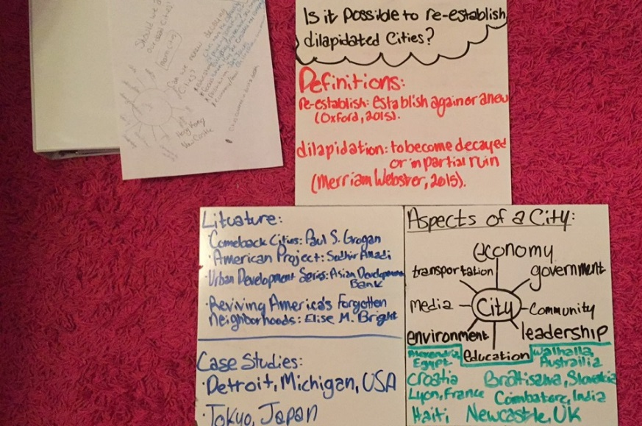
Proposal Poster
I referred back
to this picture
of my poster throughout the writing of my paper to keep
my thoughts organized.
Once I had researched and saved the notes in my word document, I erased it off of the board.

Slide 7
Reflection on Month One
My AS-level paper revolved around the effects of 21st century technologies on the fish population. Before writing that paper, I was very passionate about the environment and the effects humans have on it. So, I decided to use this class to expand my knowledge and research. But, after making my proposal form, my teacher and classmates pushed for me to explore a new topic. So, after a 2 hour discussion with my teacher afterschool, we came up with a new topic. From this, I came up with my question. Looking back, I am so glad that they pushed me to go a different route. Without this question, I wouldn’t have fallen in love with doing my own unguided research to answer a question I am truly interested in and passionate about.

Slide 8
Week Four: 7 December – 13 December
Monday the 7th: I met with my Research Report Teacher to check with my progress in forming and centering a question. Then proceeded to write my Outline Proposal Form.
Tuesday the 8th: I met with my Research Report Teacher and the two other Global students to discuss and critique my Outline Proposal Form and amend accordingly.
Wednesday the 9th: Today I turned my Outline Proposal Form to my Report Supervisor to submit into Cambridge.
Thursday the 10th – Sunday the 13th: I worked on an outline for my paper and furthered research to continue working while waiting for proposal form to return.

Slide 9
Week Five: 14 December – 20 December
This week I read and analyzed two books within the Urban Development Series written by the Asian Development Bank called Inclusive Cities and Green Cities that highlight specific dead or dying cities in Asian countries and their potential benefit to the country.
  After reading both books, I found that the book Inclusive Cities showed the revival of three Asian countries, while Green Cities just highlighted ways to make already successful cities more energy efficient and successful.
  The three areas Inclusive Cities focused on were India, Indonesia, and Philippines. I will most-likely mention India and the Philippines in my paper and expand on Indonesia.
Also on Tuesday the 15th, I received my proposal form back and it was accepted with a small revision to the wording of the question: How realistic are the prospects for revising ‘dying cities’?

Slide 10
Week Six: 21 December – 27 December
Monday the 21st – Wednesday the 23rd: I focused my research on my case study on Detroit, Michigan; USA.
Notable research:
  Business Insider article written in 2010
  Forbes Magazine article written in 2013
Saturday the 26th– Sunday the 27th: I then redirected my focus of research to complete my case study on Tokyo, Japan.
  In my beginning research, I realized that there were too many outside factors in the dilapidation and revival of the city for it to be an objective case study

Slide 11
Week Seven: 28 December – 3 January
Monday the 28th – Saturday the 2nd: I was on vacation with my family in North Carolina , but on my down time, I continued my research on the revival of ghost towns.
Notable research:
  Hebron: a Guardian article written in 2015
  Varosha, Cyprus: a 2014 CNN article
Sunday the 3rd: I started focusing my research on dilapidated cities that couldn’t recover.1
Notable research:
  Zhengzhou: a CNN news article from 2013

Slide 12
Reflecting on Month Two
This month, I finalized my question and finished my research proposal. Right after this, I started to research revived cities. When I created my proposal poster, I brain stormed many cities that I thought have been revived. I found out that most of the cities are still reviving. This is when I came across my first two books: Inclusive Cities and Green Cities within the Urban Development Series written by the Asian Development Bank. From here, I easily found outlined revivals of cities, and plans for the future. The ball was now rolling. I completed my research on my Detroit case study and found out that there were too many outside factors to have Tokyo be a credible case study. Then continued on to find three more revived cities. At this point, my paper was all research and frustration on trying to find cities that complied with my definitions and questions. My opinion was soon to change.

Slide 13
Week Nine: 4 January – 10 January
This week was used to read and analyze another piece of literature titled, Reviving America's Forgotten Neighborhoods by Elise M. Bright. This 224 page book takes an in depth look into fallen American cities, and the possibility of urban renewal in the area.
  Atlanta, Washington D.C., New Orleans, Anchorage, San Francisco, and Chicago were all cities that this book described.

Slide 14
Week Eight: 11 January – 17 January
Monday the 4th & Tuesday the 5th: I continued and finished my research on revived ghost towns
Notable research:
  Mason Gaffney’s Essay (How to Revitalize a City) presents many examples of cities from all over the world. This essay is published in his book called Essays solving the “unsolvable.”
  I collected my information from Inclusive Cities to use for this section
Wednesday the 6th – Sunday the 10th: I finished my research on the dilapidated cities that couldn’t be revived.
Notable research:
  Kitsault: an article written by George Dvrosky in 2013

Slide 15
Week Ten: 18 January – 24 January
With a detailed outline and Introduction already completed, I used this week to write two sections of my essay: The Steps to a City’s Recovery and Case Studies: Detroit and Tokyo.
  I found three different processes of revival and molded them to create
  straight forward avenues of revival:
    Mason Gaffney’s book: Essays Involving the “Unsolvable”
    Edward Glaeser’s book: Triumph of the City
    TED Talks playlist: “How to Revive a City”
  Further into my research I found that a case study on Singapore fit better
  as a case study than both Detroit and Tokyo.
  I titled this section, Case Study: Singapore’s Revision

Slide 16
Week Eleven: 25 January – 31 January
This week, I wrote two more sections in the essay: Reviving A Ghost Town and the counter argument (this section doesn’t have a more specific name yet).
  Towards the end of the week I thought up a title for my counter argument: The Uncertainty of Revival

Slide 17
Reflecting on Month Three
This is the month that changed my whole view on my topic and research as a whole; my paper turned from an assignment to a passion for answering questions. During week ten, in which I devised three cures to the blights of fallen cities, I came to this epiphany. I loved how instead of compiling quotes and examples to sufficiently answer a question, I complied different opinions and examples to personally create my own avenues of revival. This impacted me so much. For example, when I went on college tours, I made sure that I would be able to conduct research outside of my concentration as a student there.

Slide 18
Week Twelve: 1 February – 7 February
Monday the 1st & Tuesday the 2nd: I spent the last two days reviewing and editing the sections I’ve already written before moving on to the final analyzation.
Wednesday the 3rd: I read and graded past A level papers to fully understand what differentiates an “A” from a “B” to a “C”
  (I copied my notes onto the next page)
Thursday the 4th – Sunday the 7th: I wrote my final analysis and reflection on the topic.

Slide 19
Notes on the Example Essays:
Footnotes:
*has just the website or book by author*
Bold quotes
Validation
ex: soviet musicologist and professor
Definitions within the footnotes
ex: Defined as: __________
Each Section:
1) Specific topic (a person or subject)
2) Explain the topic/person
3) Validation
According to source, “information”
- Use of letters, books, graphs, pictures, etc.
- Flow quotes, only block them if needed
(don’t over use)
- Don’t use one source over and over
4) Analysis of support
5) Reflection
ex: I believe this better than that in my opinion
Process:
listed steps
1) one word/ phrase
2) an explanation
[HAS CONTENTIONS WITHIN EACH SECTION]
Conclusion:
has the final analysis
Reflection is infused into it
Use of questions
Bibliography:
Split up by sections
Formatting the sources:
www.example.com
Michael Harner ‘The way of the Shaman’
Sigmond Freud (1900) ‘the interp. Of dreams’

Slide 20
Week Thirteen: 8 February – 14 February
This entire week I spent as time away from all of my research and writing.

Slide 21
Week Fourteen: 15 February – 21 February
Monday the 15th & Tuesday the 16th: I used this time to look over my essay and make final adjustments before I turn it in for peer review.
Wednesday the 17th: I turned in my paper to my Research Report Teacher, who distributed it to the two other students for peer reviews.
Thursday the 18th: We completed our peer reviews and gave the results to each other so we could start working on revisions.
Friday the 19th – Sunday the 21st: I worked on the final revisions of my paper
  I revised some grammatical and formatting errors
  I also worked on making my paper transition and flow better
  I strengthened my analysis within each section

Slide 22
Week Fifteen: 22 February
Monday the 22nd: I arrived to school early to make sure everything was finalized and ready to be sent in to Cambridge.

Slide 23
Reflecting on Month Four
This month was spent mostly on formatting, editing, and reflecting. By looking at previous papers, I was reassured about the format of my own paper. Furthermore, I decided not to do footnotes, because, in my case, it would take time away from researching and analyzing since I am not very familiar on how to create precise and efficient footnotes. When writing my reflection and final analysis, I was finally able to really focus on the impact of my research and to formulate personal decisions on my topic.

Slide 24
Reflecting on an Independent Study
Looking back at independent study, there were many benefits and draw-backs. On the negative side, adding this class to my already full schedule resulted in a minimal amount of time to be completely focused on my research. Correspondingly, I lost a lot of face to face time with my teacher and collaboration with my peers. All of my meetings with my teacher and peers had to be done outside of school. However, I definitely benefitted by taking this course because I gained experience in writing longer, more in-depth papers. Because of the minimal amount of time and an extremely loud and busy household, I started a routine of going to the library every Wednesday to work on my paper. I also gained so much knowledge on a topic I previously knew absolutely nothing about. I learned how to not just rewire a city as
a whole, but how I, a citizen of the community could aid in the revival too.

